Slide 1

TrackR Production
Team G:
Mayurkumar Rafaliya
Prajwal Pundalika Nayak
Anusha Asokan Palat
Cathleen Mathew Mundat
Chaitanya Keesari
Jigeesha Kocher

Slide 2



Agenda
Introduction
Lead Hand’s Concerns
Factory Layout
HVAC Diagram
Spaghetti Analysis
Summary of P&L

Slide 3
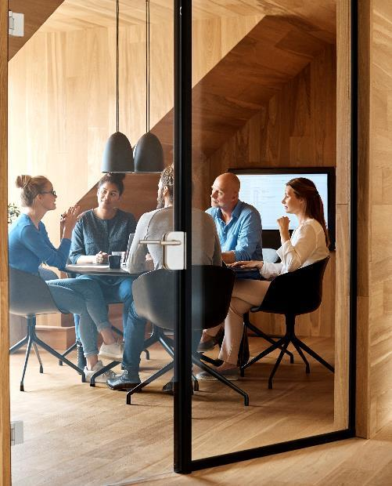



Introduction
Oury Health Tech Ltd (OHT) sells medical equipment to the local medical clinic
Focuses on quality and reliability
Developed TrackerR to enhance the business
Gained public attention
Achieved high sales record
Company might go bankrupt in 2 years due to complaints
Organization planned to hire a Business Analyst
Development of an effective dashboard to identify the metrics
Wednesday, March 30, 2022

Slide 4
Lead Hand’s Concern
Lead hand wants to reduce footsteps in the production facility
Pallets and Pallets trucks are needed to be shifted somewhere else
Reduce the pallet trucks movement in the assembly area
Assembly should be shifted to somewhere else
There is temperature issue which needs to be solved in entire production facility

Slide 5
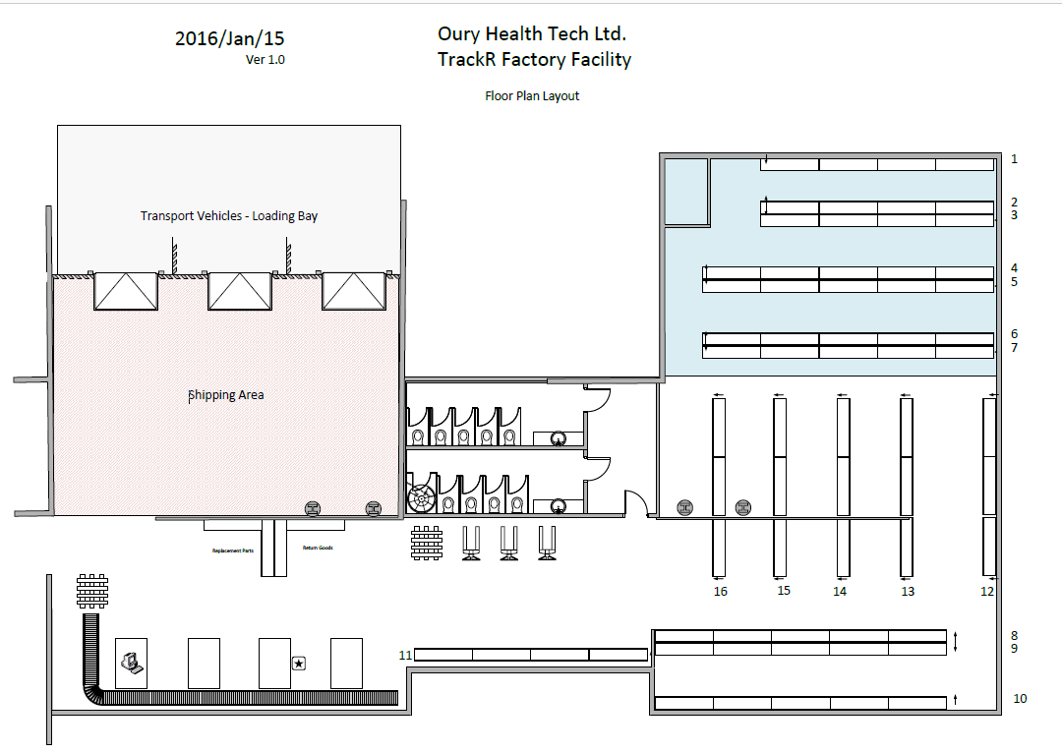
Factory Layout

Slide 6
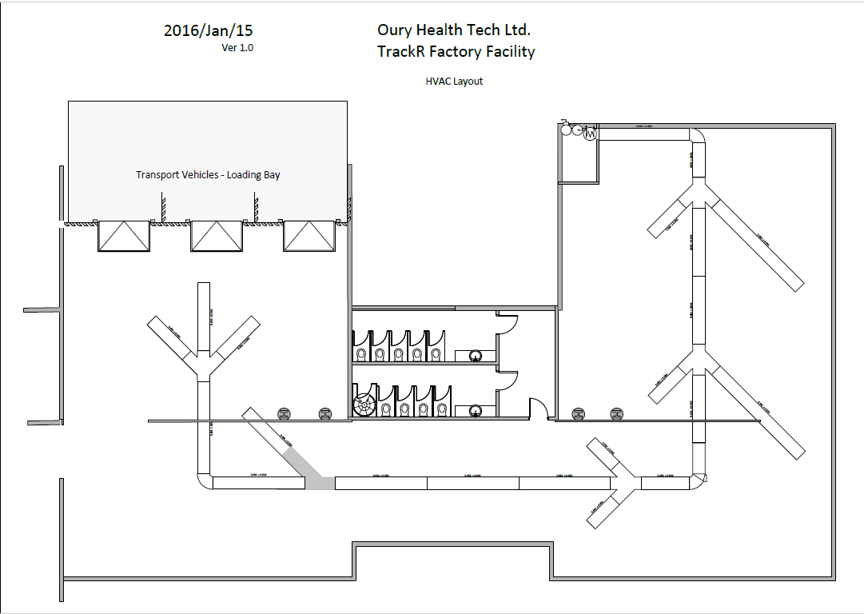
HVAC Layout

Slide 7
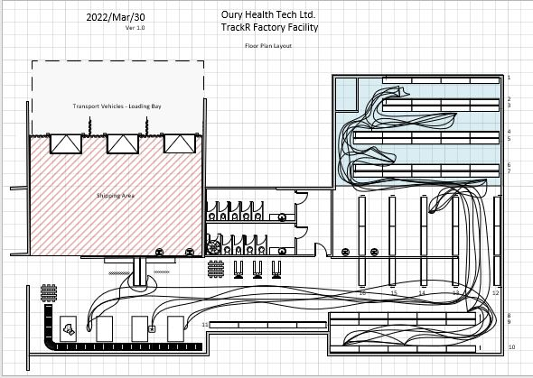
Sphagetti Analysis

Slide 8
Profit & Loss Summary
Number of Assembly Tables : 3
Number of hours in shift : 8
Number of shift : 2
Number of employees : 31
Daily TrackR Production : 354
Daily Loss of 3290

Slide 9


Thank You !!
Any Questions ??

Slide 10
References 1.EConestoga. (2022, March 30). P2 OHT Needs 21May07. EConestoga. Retrieved March 11, 2022, from https://conestoga.desire2learn.com/d2l/le/content/539481/viewContent/11890079/View 2.EConestoga. (2022, March 30). LeadHand Concerns 22Mar01. EConestoga. Retrieved March 11, 2022, from https://conestoga.desire2learn.com/d2l/le/content/539481/viewContent/12160711/View 3.EConestoga. (2022, March 30). Staff Attitude Survey Results 190327. EConestoga. Retrieved March 11, 2022, from https://conestoga.desire2learn.com/d2l/le/content/539481/viewContent/12151489/View 4.EConestoga. (2022, March 30). P2 Prodn Team Deliverables 21May07. EConestoga. Retrieved March 11, 2022, from https://conestoga.desire2learn.com/d2l/le/content/539481/viewContent/11890078/View 5.EConestoga. (2022, March 30). TrackR Picking 3D 21Oct22 0625. EConestoga. Retrieved March 11, 2022, from https://conestoga.desire2learn.com/d2l/le/content/539481/viewContent/12145606/View

